Slide 1
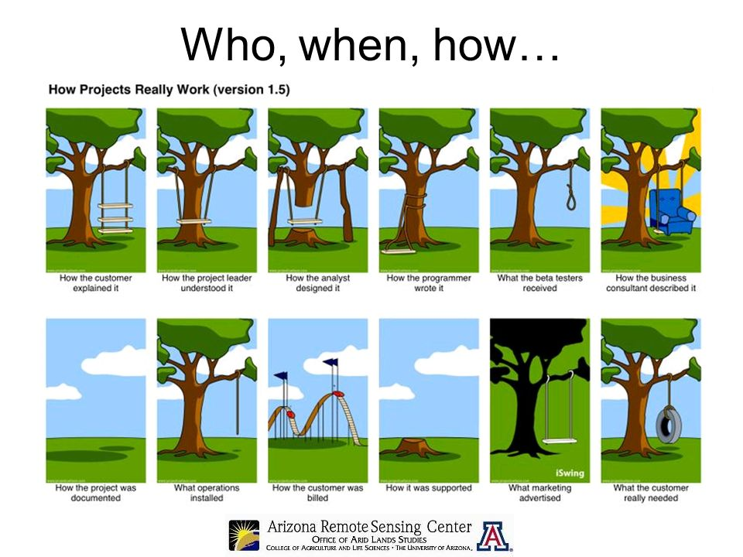

Slide 2
What is Software Engineering?
1
2
3
The power is off, and we have already dumped all the books on the floor. Now, how do we work in the dark?
Yeh, whats happening?
We are trying to clean up our bookshelf
4
5
Before you start your work, get organized! First, form a straight line and the rightmost person should start passing on the books. Once it reaches the person close to the shelf, he should say, “Received!” and you can continue this way.
Guys, there is a way out!
Notes:
This is the content slide. Enter the content for the topic in this slide. Ensure that comprehensive speaker notes are available for each slide.

Slide 3

What is Software Engineering?
What does this have to do with Software Engineering?
No matter what!
Organization plays a crucial role in any kind of job.
Software engineering does exactly this to
Software Development!

Slide 4
FEASIBILITY STUDY
Whether it is worth carrying on Requirements Engineering and system development process?
All new projects should start with a feasibility study during requirements analysis stage.
Does system contribute to the overall objectives of the organization?
Can system be implemented in the existing environment and within given cost and schedule constraints?
Can the proposed system be integrated with the existing systems which are currently active?

Slide 5
How will the organization cope if this system is not implemented?
What are all problems with current processes and how would a new system help to eliminate these problems?
Does system require new technology which has not been previously used in that organization?
Information sources for feasibility study :
1) Software engineers familiar with system
2) End Users
3) Technical Experts
Feasibility study report may propose changes to scope, budget and schedule of the system.

Slide 6
REQUIREMENTS ENGINEERING
What are Requirements ?
A condition or capability needed by a user to solve a problem or achieve an objective
A condition or capability that must be met or possessed by a system to satisfy a contract, standard, specification, or other formally imposed document
A software requirements specification (SRS) is a document containing a complete description of what the software will do without describing how it will do it.

Slide 7
Requirements…
Software requirements specify what the software must do to meet the business needs.
For example, a stores manager might state his requirements in terms of efficiency in stores management.
A bank manager might state his requirements in terms of time to service his customers.
It is the analyst's job to understand these requirements and provide an appropriate solution.
To be able to do this, the analyst must understand the client's business domain: who are all the stake holders, how they affect the system, what are the constraints, etc

Slide 8
Requirements…
The analyst should not blindly assume that only a software solution will solve a client's problem.
He should have a broader vision.
Sometimes, re-engineering of the business processes may be required to improve efficiency
A detailed statement of what the software must do to meet the client's needs should be prepared. This document is called Software Requirements Specification (SRS) document.

Slide 9
SOURCES OF REQUIRMENTS
Stakeholder wants and needs
Current organization and systems
Existing documents
Suggested types of requirements
Reusable requirements
Domain models
Current situation model

Slide 10
Template for SRS
Introduction
1.1 Purpose of requirements document
1.2 Scope of the product
1.3 Definitions, acronyms and abbreviations
1.4 References
1.5 Overview of the remainder of the document
2. General description
2.1 Product perspective
2.2 Product functions
2.3 User characteristics
2.4 General constraints
2.5 Assumptions and dependencies
3. Specific requirements covering functional, non-functional and interface requirements.
4. Appendices
5. Index

Slide 11
SOFTWARE REQUIREMENTS SPECIFICATIONS
Uses of a Requirements document
Customers – Specify the requirements and read them to check that they meet their needs. They specify changes to the requirements.
Managers- Use the document to plan a bid for the system and to plan the system development process
System engineers – Use the requirements to understand what system is to be developed
System test engineers –Use the requirements to develop validation tests for the system
System Maintenance engineers-Use the requirements to help understand the system and the relationships between its parts

Slide 12
Characteristics of a Good SRS
Correct (No errors)
Unambiguous
Complete
No use of TBDs (To Be Determined )
Verifiable (words like “highly”, “usually” not to be used)
Consistent (non-conflict)
Modifiable
Traceable

Slide 13
TYPES OF REQUIREMENTS
Physical Environment
Where is the equipment to function ?
Is there one location or several ?
Are there any environmental restrictions, such as temperature, humidity, or magnetic interference ?
Interfaces
* Is the input coming from or more other systems ?
* Is the output to one or more other systems ?
Is there a prescribed way in which the data must be formatted ?
Is there a prescribed medium that the data must use ?
Users and Human factors
* Who will use the system ?
Will there be several types of users ?
What is the skill level of each type of user ?
What kind of training will be required for each type of user ?
How easy will it be for a user to understand and use the system?
How difficult will it be for a user to misuse the system ?

Slide 14
Functionality
* What will the system do ?
* When will the system do it ?
* Are there several modes of operation ?
* How and when can the system be changed or enhanced ?
* Are there constraints on execution speed, response time ?
Documentation
*How much documentation is required?
*Should it be on-line, in book format or both ?
* To what audience is each type of documentation addressed ?
Data
For both input and output, what should be format of the data be ?
How often will they be received or sent ?
How accurate must they be ?
How much data flow through the system ?
Must any data be retained for any period of time ?

Slide 15
Resources
What materials, personnel or other resources are required to build, use and maintain the system ?
What skills must the developers have ?
What are the requirements for power, heating or air conditioning ?
Is there a limit on the amount of money to be spent on development or on hardware and software ?
Security
Must access to the system or to information be controlled ?
How often will the system be backed up ?
Should precautions be taken against fire, water damage or theft ?
Quality Assurance
What are the requirements for reliability, availability, maintainability, security and other quality attributes ?
How the characteristics of the system be demonstrated to others ?
Must the system isolate and detect faults ?
What is the MTBF ?
Is there a maximum time allowed for restarting the system after a failure?

Slide 16
Library Problem
Check out a copy of a book, return a copy of a book
Add a copy of a book to the Library
Remove a copy of a book from the library
Get the list of books by a particular author or in a particular subject area
Find out the list of books currently checked out by particular borrower
Find out which borrower last checked out a particular copy of a book
There are two types of users : Staff Users and Ordinary Borrowers. Transactions 1 and 2 are restricted to staff users
CONSTRAINTS
1. Copies in the library must be available for checkout or be checked out
2. Copy of the book may be both available and checked out at the same time
3. A borrower may not have more than a predefined number of books checked out at one time

Slide 17
Ambiguities
What is a Library ?
Who is a user ?
Confusion regarding “ Book ” and “ Copy ”
What does “ Available ” mean ?
What do “ Last Checked Out ” and “ Currently ” mean ?
Incompleteness
Initialization
Addition of a new book
Remove all copies of a book
Create a library
Add a staff user / ordinary user
Error Handling
Missing Constraints
  Period of Lending
  Not more than one copy of the same book can be borrowed

Slide 18
Further Examples for Bad Specification
The counter value is picked up from the last record.
Inversion of a square, matrix ‘M’ of size ‘n’ such as LM ML = I_{n}, where ‘L’ is the inverse matrix and I_{n} is the identity matrix of size ‘n’.
The software should be highly user friendly
The output of the program shall usually be given within 10 seconds.
The software should be developed on DOS system, but should be portable to other systems.

Slide 19
Further Examples for Bad Specification
In first statement, the word 'last' is ambiguous. It could mean the last accessed record, which could be anywhere in a random access file, or, it could be physically the last record in the file
Second statement though appears to be complete, is missing on the type of the matrix elements. Are they integers, real numbers, or complex numbers. Depending on the answer to this question, the algorithm will be different.
How does one determine, whether this requirement is satisfied or not.
What are the exceptions to the 'usual 10 seconds' requirement?

Slide 20
How Users and Developers view each other ?
How developer see users How users see developers ?
Users don’t know what they want. Developer’s don’t understand
operational needs
Users want everything right now. Developer’s can’t translate clearly
stated needs into a successful system
User’s can’t prioritize needs. Developers say no all the time.
Users refuse to take responsibility Developers are always late.
for the system
Users are unwilling to compromise Developers are unable to respond
User’s can’t remain on schedule quickly to legitimately changing needs
User’s are unable to provide a Developers try to tell us how to do our
Usable statement of needs job
Developer’s can’t translate clearly
stated needs into a system

Slide 21
Distribution of Errors in Requirements Specification
80
70
60
50
49 %
40
31 %
30
20
13 %
10
5 %
2 %
Incorrect
fact
omission
inconsistency
ambiguity
misplaced
requirement
(wrong section)
Error Type
[ NAVY A - 7E AIRCRAFTS OPERATIONAL FLIGHT PROGRAM;
5th INT. CONF. ON SOFTWARE ENGINEERING, 1981 ]

Slide 22
Relative Cost To Fix An Error
100
R
E
L
A
T
I
V
E
C
O
S
T
50
20
10
5
0.5
0.2
0.1
REQUIREMENT
DESIGN
CODE
DEVELOP-
MENT
TEST
ACCEP-
TANCE
TEST
OPERA-
TION

Slide 23
The Requirements Definition and Analysis Phase is Critical to keep the Development and Maintenance Costs to a Minimum
Types Of Requirements
Functional Requirements
- what system should do
The requirements that specify the Inputs (Stimuli) to the system, the Outputs (Responses) from the system, and the behavioral relationship between them
Non-Functional Requirements
- specify the overall quality attributes the system must satisfy.

Slide 24
Functional Requirements (Examples)
To calculate the compound interest @ 8% per annum on a Fixed Deposit for a period of three years
To calculate the Tax @ 30% on an annual income equal to and above Rs.2,00,000 but less than Rs.3,00,000
To invert a Square Matrix (Maximum size 100 X 100) of Real Numbers

Slide 25
Non-Functional Requirements
The requirements that describe the overall attributes of the system :
Portability
Reliability
Performance
Testability
Modifiability
Security
Presentation
Reusability
Understandability
Acceptance Criteria

Slide 26
Non-Functional Requirements (Examples)
Performance
Number of significant digits to which accuracy should be maintained in a numerical solution
Maximum response time in a transaction processing system
Delays and task completion time limits in a real-time system
Environment
To run the software under a given operating system or use a specific programming language
Security
The addition and deletion of the book in the system can be carried out by the Library-Chief only

Slide 27
Types of Satisfiability
Normal Requirements
* User responses to specific questions
* Satisfy / dissatisfy in proportion to their
presence / absence in system
Expected Requirements
Exciting Requirements

Slide 28
Expected Requirements
Expected requirements may not be stated by the users, but the developer is expected to meet them. So basic that users may neglect to mention them
Their presence in solution may meet expectation but not enhance satisfaction
Absence is very dissatisfying
"Most Important" for analyst

Slide 29
Exciting Requirements
Beyond the users’ expectations; cannot be elicited from users
Highly satisfying when met
Their absence doesn’t dissatisfy because they are not expected

Slide 30
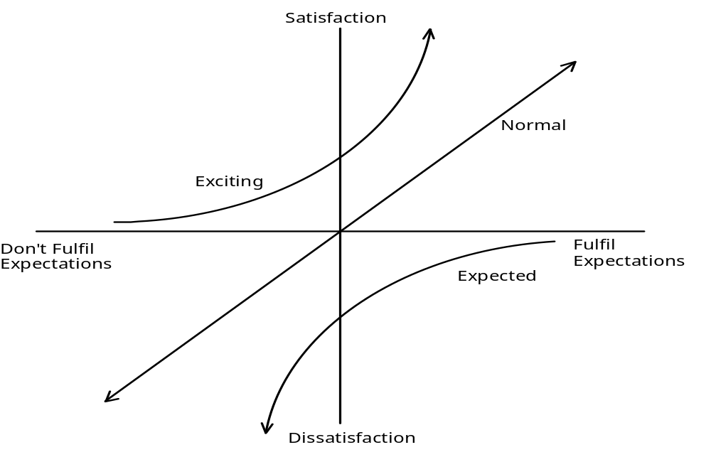
Satisfiability
Normal, Expected and Exciting Requirements

Slide 31
The Trend over the Years
Exciting requirements often become normal requirements
Some normal requirements become expected requirements
For example, on-line help feature was first introduced in the UNIX system in the form of man pages. At that time, it was an exciting feature. Later, other users started demanding it as part of their systems. Now a days, users do not ask for it, but the developer is expected to provide it.

Slide 32
Modeling Requirements
Every software system has the following essential characteristics:
It has a boundary. The boundary separates what is with in system scope and what is outside
It takes inputs from external agents and generates outputs
It has processes which collaborate with each other to generate the outputs
These processes operate on data by creating, modifying, destroying, and querying it
The system may also use data stores to store data which has a life beyond the system

Slide 33
SSADM tools
Data Flow Diagram (DFD) for modeling processes and their interactions.
Entity Relationship Diagram (ERD) for modeling data and their relationships.
Decision Tables and Decision Trees to model complex decisions.
State Transition Diagram to model state changes of the system.
Data Dictionary is a repository of various data flows defined in a DFD.

Slide 34
Points to remember
1) Remember to name every external agent, every process, every data store, and every dataflow.
2) Do not show how things begin and end.
3) Do not show loops, and decisions.
4) Do not show data flows between external agents. They are outside the scope of the system.
5) Do not show dataflow between an external agent and a data store. There should be a process in between.

Slide 35
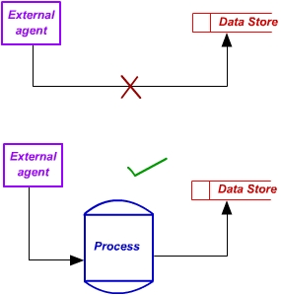
Points to remember

Slide 36
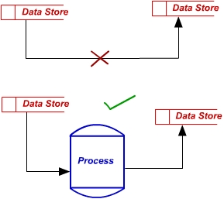
6) Do not show dataflow between two data stores. There should be a process in between.

Slide 37
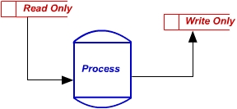
7) There should not be any unconnected external agent, process, or data store.
8) Beware of read-only or write-only data stores

Slide 38
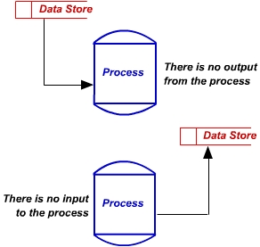
9) Beware of processes which take inputs without generating any outputs. Also, beware of processes which generate outputs spontaneously without taking any inputs

Slide 39
10) Ensure that the data flowing in to a process exactly matches the data flowing in to the exploded view of that process. Similarly for the data flowing out of the process.
11) Ensure that the data flowing out of a data store matches data that has been stored in it before.

Slide 40
DECISION TREE
A decision tree represents complex decisions in the form of a tree. Though visually it is appealing, it can soon get out of hand when the number and complexity of decisions increase. An example is given below.
First the textual statement is given and then the corresponding decision tree is given:
Rules for electricity billing are as below:
If the meter reading is "OK", calculate on consumption basis(i.e. meter reading)
If the meter reading appears "LOW", then check if the house is occupied
If the house is occupied, calculate on seasonal consumption basis otherwise calculate on consumption basis
If the meter is damaged, calculate based on maximum possible electricity usage

Slide 41
DECISION TREE
consumption basis
if house empty calculate
if meter reading
Low if house occupied seasonal
consumption basis
if meter reading
NORMAL consumption basis calculate
maximum possible usage
if meter damaged calculate

Slide 42
DECISION TABLE
There are two types of decision tables, binary-valued(yes or no) and multi-valued. An example follows:
ELECTRICITY BILL CALCULATION BASED ON CUSTOMER CLASS
If a customer uses electricity for domestic purposes and if the consumption is less than 300 units per month then bill with minimum monthly charges.
Domestic customers with a consumption of 300 units or more per month are billed at special rate.
Non-domestic users are charged double that of domestic users (minimum and special rates are double).

Slide 43
BINARY VALUED DECISION TABLE
Domestic Customer | Y | Y | N | N
Consumption < 300 units/month | Y | N | Y | N
Minimum Rate | Y | N | N | N
Special Rate | N | Y | N | N
Double Minimum Rate | N | N | Y | N
Double Special Rate | N | N | N | Y

Slide 44
MULTIVALUED DECISION TABLE
CUSTOMER | D | D | N | N
CONSUMPTION | >=300 | <300 | >=300 | <300
RATE | S | M | 2S | 2M

Slide 45
Like decision trees, binary-value decision tables can grow large if the number of rules increase. Multi-valued decision tables have an edge. In the above example, if we add a new class of customers, called Academic, with the rules:
If the consumption is less than 300 units per month then bill with concessional rates. Otherwise bill with twice the concessional rates. then new tables will look like the following:

Slide 46
BINARY VALUED DECISION TABLE
ACADEMIC | N | N | N | N | Y | Y
DOMESTIC CUSTOMER | Y | Y | N | N | N | N
CONSUMPTION < 300UPM | Y | N | Y | N | Y | N
MINIMUM RATE | Y | N | N | N | N | N
SPECIAL RATE | N | Y | N | N | N | N
TWICE MINUMUM RATE | N | N | Y | N | N | N
TWICE SPECIAL RATE | N | N | N | Y | N | N
CONCESSION RATE | N | N | N | N | Y | N
TWICE CONCESSION RATE | N | N | N | N | N | Y

Slide 47
MULTIVALUED DECISION TABLE
CUSTOMER | DOMESTIC | DOMESTIC | NONDOMESTIC | NONDOMESTIC | ACADEMIC | ACADEMIC
CONSUMPTION | >=300 | <300 | >=300 | <300 | >=300 | <300
RATE | SPL | MIN | TWICE SPL | TWICE MIN | TWICE CONC | CONCESSIONAL

Slide 48
Requirements and design
In principle, requirements should state what the system should do and the design should describe how it does this
In practice, requirements and design are inseparable

Slide 49
What Case Tools Can Do ?
Graphic Tool
  Data Flow Diagram
  Flowchart
  Entity Relationship Diagram
  Structure Charts
  State-Transition Diagrams
Dictionary Tools
  Contents of Files
  Inputs and Outputs
  Properties of Data Elements
  Logic Rules for Processes

Slide 50
What Case Tools Can Do ?
Code Generators
Cost-Benefit Analysis Tools
Project Management Tools
Configuration Management Tools
Documentation Assemblers
  Technical and Non-Technical
  With Interfaces to popular Word Processors
Test Data Generators
Path Coverage Analyzers

Slide 51
Data-Flow diagrams
A graphical representation of the system
Used to study how information enters a system, and how it is transformed as it flows through the system
Uses symbols to represent
  External entities
  Processes
  Data flow
  Data store

Slide 52
DFD Notation
Data-Flow diagrams
External Entity
(A source of data to the system
or a destination from the system)
Or
Identifier
Process
(This represents one or more
activities which modify data)
1
Or
Data Flow
(Represents passage of data
between processes)
Duplication
Symbol
Identifier
Data Store
(Represents a place where data
is kept within the system)
D1
Notes:
Note:
The DFD notations may differ according to the conventions followed in each book.

Slide 53
Level of DFDs
Data-Flow diagrams
Level 0 - Overview showing scope
(5-10 subsystems/processes)
Level 1 - Working model, whole system
All “normal” processing
(20 - 50 processes)
Level 2 - Explosion of 1 process on DFD/1
Shows normal, error and exception processing
(5-15 processes)

Slide 54
Data-Flow diagrams
DFD using Structured Analysis
The following guidelines are to be followed while constructing DFDs using the structured analysis method:
  Study the physical environment of the existing system
  Construct a DFD for the current non-automated system
  Construct a logical DFD by using the physical DFD as the basis
  Construct the logical DFD of the proposed system to show how data will flow in the new system
  Establish a man machine boundary by specifying what needs to be automated and what will remain manual for the new system in the DFD
  Present the evaluated specifications

Slide 55
Data-Flow diagrams
Graphical Guidelines for DFDs
Identify external entities
Identify inputs and outputs (to and from external entities)
Produce first draft of DFD
Compare first draft with the first two points mentioned above
Check each data store: Is it created and maintained ?
Produce second draft
Conduct walkthroughs
Produce explosions
Produce final DFD

Slide 56
Data-Flow diagrams
Sample Level 0 DFD - Computer books by Mail
Level 0
BOOK DATA
PUBLISHER DATA
Orders
Purchase reqs
CUST.
PROCESS
ORDERS
PUB.
Invoices
Invoices
CUSTOMER DATA

Slide 57
Sample Level 1 DFD - Process Orders
Data-Flow diagrams
Level 1
D1
BOOK DATA
D2
PUBLISHER DATA
Book details
address
1
4
order
Valid orders
Assemble
Req. to
Publisher
Purchase req.
CUST.
Verify
Order
PUB.
Batched
orders
Credit
status
D4
PENDING ORDERS
D3
CUSTOMERS

Slide 58
Sample Level 2 DFD – Handling Shipments from Publishers
Data-Flow diagrams
Level 2
D1
BOOK DATA
D2
PUBLISHER DATA
Book details
address
1
4
order
Verify
Order
Valid orders
Assemble
Req. to
Publisher
Purchase req.
CUST.
PUB.
Batched
orders
Credit
status
Purchase req.
D4
PENDING ORDERS
D3
CUSTOMERS
Orders
by
title
D5
PUBLISHER ORDERS
Shipping
note
address
P.O. details
2
6
5
Fillable orders
Titles, qtys
Shipping note
Assemble
Customer
Orders
Assign
Shipment to
Pending
orders
Verify
shipment

Slide 59
Sample Case Study - 1
Data-Flow diagrams
Problem Statement:
Mr. Roy Chowdry, a restaurant owner feels that is business can do better when the existing operations in the system are automated.
Steps involved in constructing a DFD
Identify the client and the potential users of the system
Observe the client practices and design a context diagram for the same
Identify and establish the goals of the proposed system
Identify the major files in the system
Identify the major processes in the system
Construct a DFD

Slide 60
Constructing a DFD – Step 1
Data-Flow diagrams
Identifying the different users of the system:
Client:
  The Restaurant owner
Potential Users:
  Waiters, cash register operator

Slide 61
Constructing a DFD – Step 2
Data-Flow diagrams
The context diagram for the restaurant:
SUPPLIER
Order for supplies
Supplies Information
supplies
RESTAURANT
Menu
Payment
Orders
Sales Information
Receipt
CUSTOMER
Final Bill
Served Bills

Slide 62
Constructing a DFD – Step 3
Data-Flow diagrams
Goals to be achieved:
Automate much of the order processing and billing
Automate accounting
Make supply ordering accurate so as to ensure that:
  The leftovers at the end of the day are minimized
  The rejected orders due to non availability are also minimized
Statistical data and reports on food supplies and sales of different items on a periodic basis

Slide 63
Constructing a DFD – Step 4
Data-Flow diagrams
Major files in the system
  Supplies file
  Accounting file
  Orders file
  Menu file

Slide 64
Constructing a DFD – Step 5
Data-Flow diagrams
Major Processes in the system
  Process Supplies
  Make Dishes
  Process Order
  Produce Bill
  Payment Receipt
  Place Supply Order
  Check for discrepancy
  Supplies Payment
  Check for discrepancy
  Accounting reports
  Statistics

Slide 65
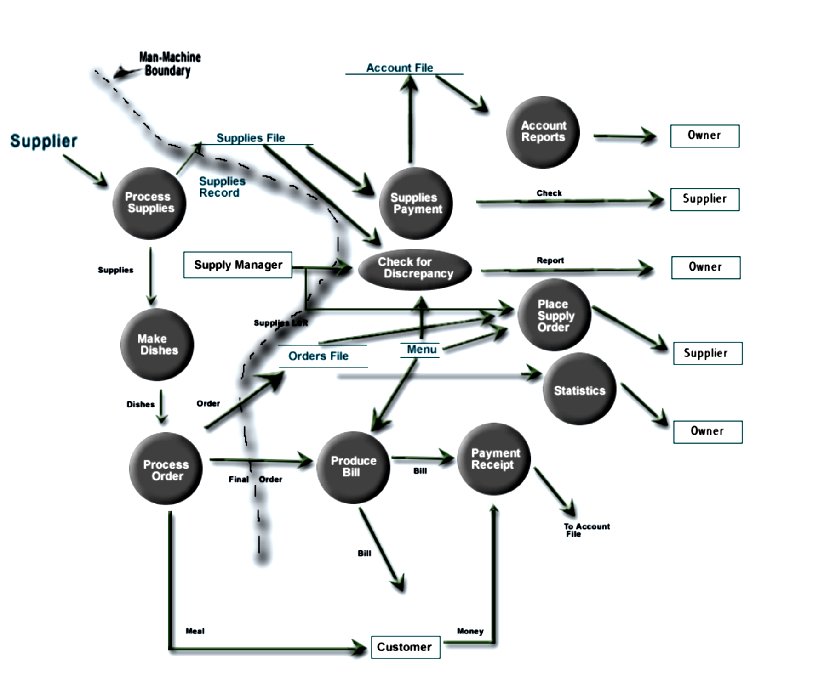
Data-Flow diagram: The Final Step - DFD

Slide 66
Data dictionary
Components in the structure of data flow and structure of files
are also shown in Data Dictionary.
Various notations used in Data Dictionary are + , | and *
+ indicates sequence or composition
| is used for selection (one OR the other)
* Is used to represent repetition (one or more occurrences)

Slide 67
Data Dictionary for Restaurant
Supplies_file = [date + [item_no + quantity + cost]*]*
Orders_file = [date + [menu_item_no + quantity + status]*]*
Status = satisfied | unsatisfied
Order = [menu_item_no + quantity]*
Menu = [menu_item_no + name + price + supplies_used]*
supplies_used = [supply_item_no + quantity]*
Bill = [name + quantity + price]* + total_price + sales_tax
+ service_charge + grand_total
Discrepancy report =[supply_item_no + amt_ordered +
amt_left + amt_consumed + descr]*

Slide 68
Sample Case study - 2
Data-Flow diagrams
Generating a DFD for an Air Traffic Controller System
Requirements of the ATCS
Receive information from the aircraft about its co-ordinates and velocity
Process the information at specified intervals
Update the traffic data base
Provide information to the air traffic controller when queried
Design constraints
Data acquisition at specified intervals
Analysis within specified execution time
Updating of traffic database at defined intervals
Controller interaction must not slow down other system functions

Slide 69
DFD Level 0 for ATCS
Data-Flow diagrams
Controller display
Aircraft
Display information
Queries
Air traffic controller
ATCS
Traffic database

Slide 70
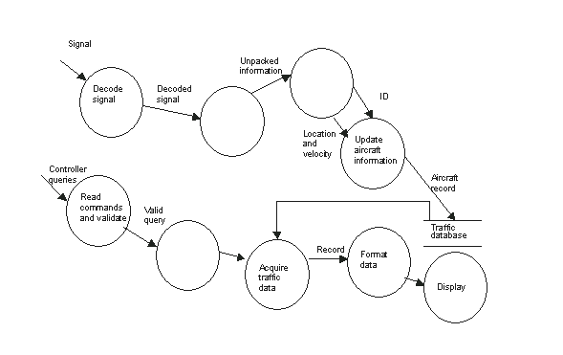
Data-Flow diagrams
DFD - Level 1 for ATCS

Slide 71
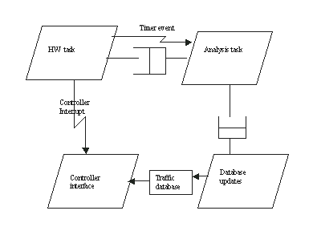
Task architecture
Data-Flow diagrams

Slide 72
Mapping of functions
Data-Flow diagrams
HW task does the following
  Generating timer events
  Handling signal from aircraft
  Generating interrupt on controller interactions
Analysis task does the following
  Processes the signal information to obtain the aircraft information.
  Queues the information for updating database.
Database updates task does the following
  Reads the aircraft information
  Updates the traffic database
Controller interface task does the following
  Reads the queries from controller and validates them
  Fetches information from the traffic database
  Displays the response for the controller

Slide 73
Entity-Relationship Diagrams
A pictorial representation of entities, their attributes and the relationships between the entities.
What are entities in ERD?
A real world object within the scope of the system about which information has to be stored
Example
  In a banking system, Customer and Transaction are some of the entities
Attributes in ERD
Refer to the properties of an entity
Each entity has an associated set of attributes
Example:
  For the entity Customer, the attributes could be Account_Number, Customer_name, Customer_address, and Account_type

Slide 74
Some important ERD notations
Entity-Relationship Diagrams
Entity →
Dependant/Sub Entity →
Attribute →
Notes:
Subtypes and Supertypes
There is a classification available in entities namely Subtype and Supertype.
For example, in an organisation, there are many employees, who belong to any of the two categories – Salaried and Daily wage. Here, the main entity is EMPLOYEE, which is classified further into SALARIED and DAILY-WAGE employees. Hence, in this case, EMPLOYEE is a supertype, and SALARIED and DAILY-WAGE employees are the subtypes. Thus a subtype is a subset of supertype.
The main reason for this classification is to avoid repetition of data. When you classify entities into supertype and subtypes, the common attributes like EmployeeCode, EmployeeName etc. can be grouped under supertype EMPLOYEE. Some attributes, which are applicable only to specific categories of employees, can be grouped under the subtypes DAILY-WAGE and SALARIED employees.
For example, attributes like ‘Overtime’ and ‘Daily wages’ belonging to daily wage employees do not belong to salaried employees. Similarly attributes like ‘Salary’ and ‘Allowance’ belonging to salaried employees do not belong to daily wage employees.
Note:
A subtype is always dependent on the supertype for its existence. The attributes of the supertype apply to all of its subtypes. But attributes of the subtype may not apply to its superentity. A subtype is always dependent on the supertype for its existence. The attributes of the supertype apply to all of its subtypes. But attributes of the subtype may not apply to its superentity.

Slide 75
Symbols used in ERD
Entity-Relationship Diagrams
There can be different types of relationships between entities
Relationships are depicted using the notations given below:
Entity A is associated with exactly one instance of entity B (Also, called a one-one relationship)
A
B

Slide 76
Symbols used in ERD
Entity-Relationship Diagrams
Entity A is associated with either zero or one instance of entity B
A
B

Slide 77
Symbols used in ERD
Entity-Relationship Diagrams
Entity A is associated with either one or more instances of entity B
A
B

Slide 78
Symbols used in ERD
Entity-Relationship Diagrams
Entity A is associated with either zero, one or more instances of entity B
A
B

Slide 79
Symbols used in ERD
Entity-Relationship Diagrams
Entity A is associated with more than one instance of entity B
A
B

Slide 80
Sample Case Study
Entity-Relationship Diagrams
AMZ Bank has decided to computerize its operations, as it finds it difficult to manage its wide customer and employee network
The major requirements of the bank are given below:
  Bank has multiple branches across the city. Each branch is identified by a unique branch name.
  Each customer of the bank is identified by a unique customer ID
  Bank employees are identified by their employee IDs

Slide 81
Sample Case Study …contd.
Entity-Relationship Diagrams
  The bank offers two types of accounts – Savings account and Fixed Deposit account. An account can be held by more than one customer, and a customer can have more than one account
  The branch decides on the loans to be issued to one or more customers. A loan is identified by a unique Loan Number.
  For each loan, the bank keeps track of the loan amount. Apart from this, the branch also maintains the payment details of the loan like Payment Number for each loan, the date and amount for each payment.
  The bank also maintains the personal as well as the transactional details of its customers and employees
  Note: A payment can exist only if there is a loan.

Slide 82
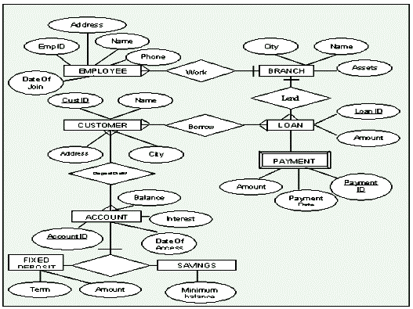
Entity-Relationship Diagrams: ERD for the Banking System
Notes:
The following lists out the various entity sets identified and their attributes.
Entity Name: BRANCH
Attributes
Name Name of the branch, acting as a unique identifier
City City in which the branch is located
Assets Assets maintained in each branch
Entity Name: CUSTOMER
Attributes
CustID Unique Identification number for each customer
Name Name of the customer
Address Address of the customer
City City in which the customer resides
Entity Name: EMPLOYEE
Attributes
EmpID Unique Identification number for each employee
Name Name of the employee
Address Name of the employee’s dependent
Phone Phone number of the employee
DateOfJoin Date on which the employee joined
Entity Name: ACCOUNT
Entity Type: Supertype
Attributes
AccountID Unique Identification number for each account
Balance Balance available in the account on a particular date
Interest Rate of Interest offered by the branch
DateOfAccess Date on which the account was last accessed
Entity Name: FIXED DEPOSIT
Entity Type: Subtype
Attributes
Term Period for which the deposit has been made
Amount Amount to be repaid on the date of maturity
Entity Name: SAVINGS
Entity Type: Subtype
Attributes
Minimumbalance Minimum balance to be retained in the account
Entity Name: LOAN
Entity Type: Independent
Attributes
LoanID Unique Identification number for each loan
Amount Amount issued as loan
Interest Rate of Interest charged for the loan
Entity Name: PAYMENT
Entity Type: Dependent
Attributes
PaymentID Unique Identification number for each loan
PaymentDate Date on which the loan was repaid
Amount Amount repaid on the payment date
Relationships
The following lists out the various relationships identified between the entities.
1. Borrow, a many-to-many relationship between CUSTOMER and LOAN.
One customer can borrow any number of loans. Similarly, a loan can be issued to many customers.
2. Lend, a many-to-one relationship between BRANCH and LOAN.
A branch can issue any number of loans. But a loan can be issued in only one branch, in which the customer has an account.
3. Deposit, a many-to-many relationship between CUSTOMER and ACCOUNT.
One customer can maintain many accounts in a branch. Similarly, an account can be maintained by many customers.
4. Work, a many-to-one relationship between EMPLOYEE and BRANCH.
A branch can have many employees. But one employee can work in only one branch at a time.

Slide 83
Question 1 : Suppose you are given the following requirements for a
simple database for the National Hockey League (NHL):
the NHL has many teams,
each team has a name, a city, a coach, a captain, and a set of players,
each player belongs to only one team,
each player has a name, a position (such as left wing or goalie),
a skill level, and a set of injury records,
a team captain is also a player,
a game is played between two teams (referred to as host_team and
guest_team) and has a date (such as May 11th, 1999) and a
score (such as 4 to 2).
Construct a clean and concise ER diagram for the NHL database.

Slide 84
Question 2: A university registrar’s office maintains data about the following entities:
courses, including number, title, credits, syllabus, and prerequisites;
course offerings, including course number, year, semester, section number, instructor(s), timings, and classroom;
students, including student-id, name, and program;
instructors, including identification number, name, department, and title.
Further, the enrollment of students in courses and grades awarded to students in each course they are enrolled for must be appropriately modeled. Construct an E-R diagram for the registrar’s office. Document all assumptions that you make about the mapping constraints.

Slide 85
Question 3 : Construct an ER Diagram for Company having following details :
Company organized into DEPARTMENT. Each department has unique name and a particular employee who manages the department. Start date for the manager is recorded. Department may have several locations.
A department controls a number of PROJECT. Projects have a unique name, number and a single location.
Company’s EMPLOYEE name, ssno, address, salary, sex and birth date are recorded. An employee is assigned to one department, but may work for several projects (not necessarily controlled by her dept). Number of hours/week an employee works on each project is recorded; The immediate supervisor for the employee.
Employee’s DEPENDENT are tracked for health insurance purposes (dependent name, birthdate, relationship to employee).

Slide 86
State Transition Diagrams
Used to indicate how the proposed system will behave in response to certain events
Represent various states of the system and their transitions

Slide 87
Symbols used in State Transition Diagrams
State Transition Diagrams
State
Transition
Condition
Action
condition
action
Notes:
27
25
26
25
30
30

Slide 88
A Sample State Transition Diagram
State Transition Diagrams
Other
Change Return
Store
Empty Change Holder
NULL
50c
Choice - Cola
Store
Change Return
Dispense Change
Dispense-Cola
50 CENT
50c
Choice- Beer
Store
$1
Dispense- Beer
Store
$1
Change Return
Dispense Change
Notes:
28
25
26
25
30
30

Slide 89
Construct a State Transition Diagram
A coin change machine helps customers with change for $1 bills and $5 bills. When a customer inserts a bill, the machine checks if it is $1 or $5. If it is one of the two, it either returns four quarters or twenty quarters, respectively. If it is not one of the two, it rejects it. If there is not enough coins left to provide change for a $1, the machine illuminates alight and does not accept any bills. If the machine does not have enough coins for $5, it illuminates another light and does not accept any $5 bills. Identify the actors and use cases. For each use case, write down the scenario. Draw an use case diagram showing how the actors are related to the use cases. Also show the use cases that are extends and the ones that are uses.

